Slide 1

Concept Prototypes
Ansar Ahmed
Alvin John Tolentino
Linton Dsouza
Quing Rosete
Shahzil Siddiqui

Slide 2
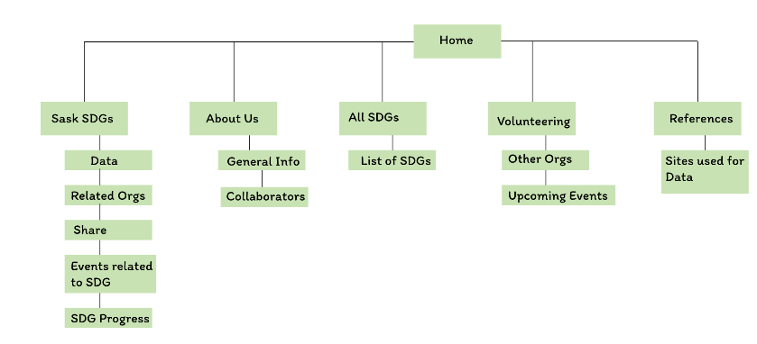

Envisioned Site Map

Slide 3
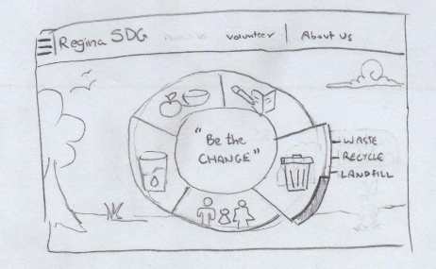
Low Fidelity Prototypes: Home Page
Concept 1
Interactive Wheel
Inspiring Quote Centered
Regina Background

Slide 4
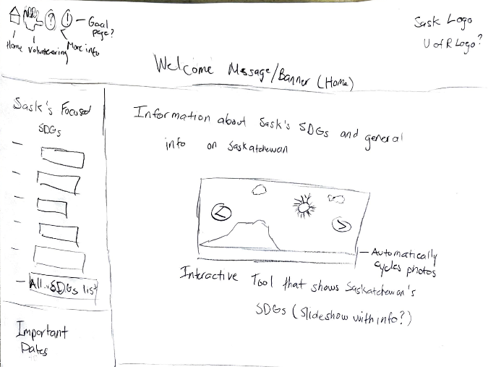
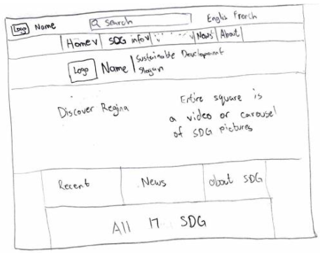
Low Fidelity Prototypes: Home Page
Concept 2
Traditional Navigation
Carousel of progressive efforts in regina galvanize action
2.1
2.2

Slide 5
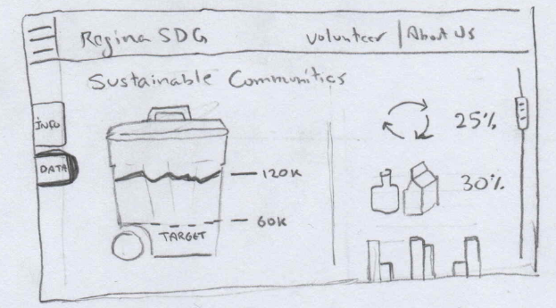
Low Fidelity Prototypes: SDG Page
Data Section
Digestible Data
Infographics
Facts

Slide 6
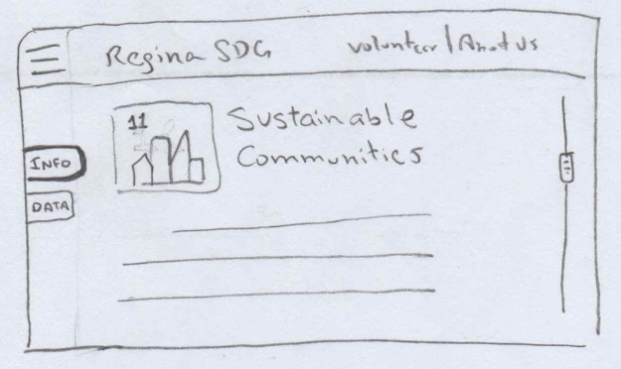
Low Fidelity Prototypes: SDG Page
Description Section
SDG Details
Testimonials
Stories
How Can I Help Section

Slide 7
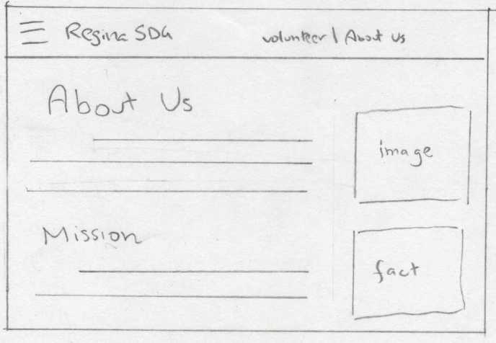
Low Fidelity Prototypes: About Us Page
Who are we?
Info on Involved Parties
Our Mission
Local Highlights
References for Data Used

Slide 8
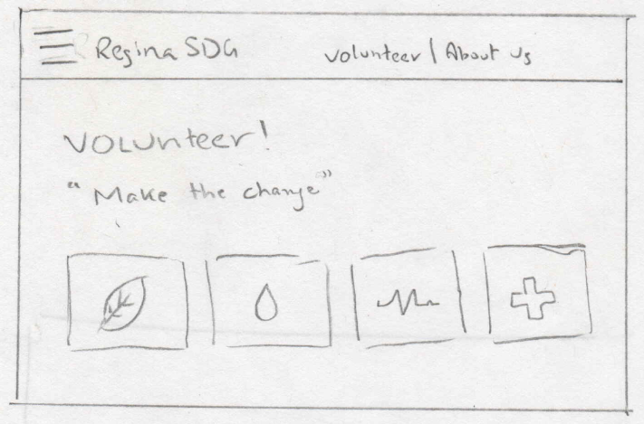
Low Fidelity Prototypes: Volunteer Page
Galvanize Action
Local SDG Volunteer Links
Local NGO Donation Links
Stories
How can I help?

Slide 9
Our Questions to you!
Which Concept do you like better for the Home Page?
Interactive Wheel (Pro = ease of navigation)
Photo Carousel (Pro = motivating users to get involved)
Will we have multiple subcategories for each SDG?
Health Diabetes, Heart Attacks, Life Expectancy, etc…
Should we include a search bar?

